Slide 1

Introduction to Data Assimilation & Gridpoint Statistical Interpolation System (GSI)
2016 Hurricane WRF Tutorial, Jan 25-27, 2014, College Park, MD
Hui Shao
Developmental Testbed Center
Notes:
1) Basic variational data assimilation concept
What is data assimilation for NWP and history
Variational method (cost function). Background, observation, BE (variance, impact scale, balance), observation error, observation operator, optimal, iteration. Important concept to understand other DA talks (10 minutes)
Other methods
2) GSI history and current status (john’s talk: 8)
3) Introduction to community GSI and available resources to learn GSI (AMS talk 5 minute)
4) General introduction to the GSI lectures in this HWRF tutorial (2 minutes).

Slide 2
Outline
What is data assimilation?
GSI concepts and methods
Community support and service

Slide 3
What is Data Assimilation
1. Data Assimilation Concepts 2. GSI Concepts and Methods 3. Community Support
Numerical Weather Prediction (NWP)
Given an estimate of the current state of the atmosphere (initial conditions), and appropriate surface (and lateral, if regional) boundary conditions, the model simulates the atmospheric evolution (forecasts)
“Knowing the current state of the weather is as important as the numerical computer models processing the data.”-NOAA National Climatic Data Center
Model-based guess
Observation-based guess
Combined guess
x
t₀
Time

Slide 4
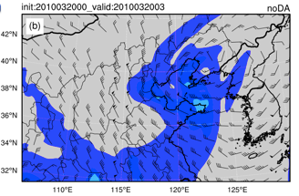
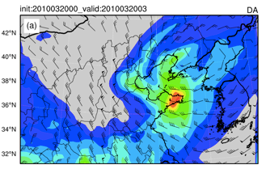

What is Data Assimilation (Cont.)
1. Data Assimilation Concepts 2. GSI Concepts and Methods 3. Community Support
+
=
Observations (y): provide an incomplete description of the atmospheric state, but bring up to date information
Background (x_{b}): gives a complete description of the atmosphere, but errors grow rapidly in time
Analysis (x_{a} at t=t₀)
Initial conditions
Data assimilation: combines these two sources of information to produce an optimal (best) estimate of the atmospheric state
Forecast model
x_{a}= w_{b}x_{b} + w_{o}y = x_{b} + K(y-x_{b})
How to find optimal weighting for background information and observations?
Forecast
(x_{t})
Notes:
“Data assimilation is an analysis technique in which the observed information is accumulated into the model state by taking advantage of consistency constraints with laws of time evolution and physical properties”-F. Bouttier and P. Courtier, ECWMF Data Assimilation Training, 1999

Slide 5
Introduction to GSI
1. Data Assimilation Concepts 2. GSI Concepts and Methods 3. Community Support
GSI used in NCEP operations for
Regional: NAM, HWRF
Global: GFS
Analysis system: RTMA
NOAA: RAP, HRRR
GMAO collaboration: GEOS
Operational at AFWA
Modification to fit into WRF and NCEP infrastructure
Evolution to Earth System Modeling Framework (ESMF)
Community support and distribution are handled by the Developmental Testbed Center (DTC)

Slide 6
Methodology
1. Data Assimilation Concepts 2. GSI Concepts and Methods 3. Community Support
GSI is a variational(Var) data assimilation system, with hybrid options
Variational methods are based on the maximum likelihood combination of observation and background information
It can be shown that the most probable state of the atmosphere given a background X_{b} and some observations Y is that which minimizes a cost or penalty function J
The solution obtained is optimal in that it fits the prior (or background) information and measured observations respecting the uncertainty in both

Slide 7
3D-Var Cost Function
1. Data Assimilation Concepts 2. GSI Concepts and Methods 3. Community Support
Analysis (model state)
Observation operator
Background
Observation error covariance
Background error covariance
Observations
Background term: J_{b}
Observation term: J_{o}
Observations within a specified time window are assimilated at one time

Slide 8
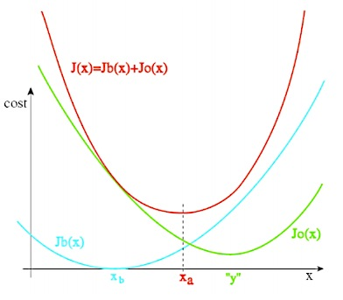
Minimizing Cost Function
1. Data Assimilation Concepts 2. GSI Concepts and Methods 3. Community Support
Optimal x_{a} is obtained by minimizing the cost function
H^{T} is called the Adjoint of the linearized observation operator
Assuming state variable x and the final analysis x_{a} remains close enough, we can derive
Observation-based correction to background

Slide 9


Example: One-point Observation
1. Data Assimilation Concepts 2. GSI Concepts and Methods 3. Community Support
A scalar example: x here represents the temperature (T) outside
J (T) = ½ (T-T_{b})σ_{B}⁻¹(T-T_{b}) +½(T_{o}-T)σ_{R}⁻¹(T_{o}-T)
T_{a}?
T_{o}=30F
σ_{R}=0.2F
T_{b}=32F
σ_{B}=0.8F

Slide 10
Example: One-point Observation (cont.)
1. Data Assimilation Concepts 2. GSI Concepts and Methods 3. Community Support
Scalar example: What is the temperature analysis (x_{a}->T_{a})?
σ_{B}⁻¹(T_{a}-T_{b})-σ_{R}⁻¹(T_{o}-T_{a})=0
T_{a}=σ_{B}T_{o}(σ_{B}+σ_{R})⁻¹+σ_{R}T_{b}(σ_{B}+σ_{R})⁻¹=30.4F
T_{a}=30.4F
T_{o}=30F
σ_{R}=0.2F
T_{b}=32F
σ_{B}=0.8F

Slide 11
Hypotheses Assumed
1. Data Assimilation Concepts 2. GSI Concepts and Methods 3. Community Support
Linearized observation operator: the variations of the observation operator in the vicinity of the background state are linear:
for any x close enough to x_{b} :
H(x) –H(x_{b}) = H(x – x_{b}), where H is a linear operator
Non-trivial errors: B and R are positive definite matrices
Unbiased errors: the expectation of the background and observation errors is zero, i.e., < x_{b}-x_{t} >= < y-H(x_{t}) > = 0
Uncorrelated errors: observation and background errors are mutually uncorrelated i.e. < (x_{b}-x_{t})(y-H[x_{t}])^{T} >=0
Linear analysis: we look for an analysis defined by corrections to the background which depend linearly on background observation departures.
Optimal analysis: we look for an analysis state which is as close as possible to the true state in an r.m.s. sense
i.e. it is a minimum variance estimate
it is closest in an r.m.s. sense to the true state x_{t}
If the background and observation error pdfs are Gaussian, then x_{a} is also the maximum likelihood estimator of x_{t}

Slide 12
Observation Term (J_{o})
1. Data Assimilation Concepts 2. GSI Concepts and Methods 3. Community Support
Observation operator: H
Most (traditional measurements)
3D interpolation
Some (non-traditional)
Complex function, e.g.,
Radiance= f(t,q), where f is a radiative transfer model
Radar Reflectivity = f(q_{r},q_{s},q_{h})
Observation innovation: y-Hx
x
x
x
x
x
x
x
x
y
x
x
x
x
y
x
x
x
x
Observation error covariance: R
Instrument errors + representation errors
No correlation between two observations (Typically assumed to be diagonal)

Slide 13
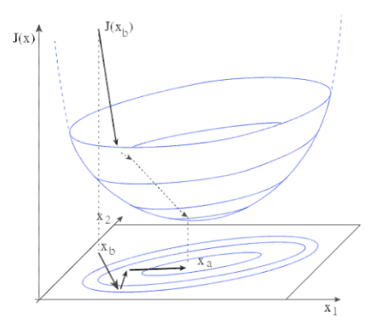
Background Term
1. Data Assimilation Concepts 2. GSI Concepts and Methods 3. Community Support
Analysis: x
Start from x=x_{b}
Analysis increment: x-x_{b}
Background error covariance: B
Controls influence distance
Contains multivariate information
Controls amplitude of correction to background
For NWP, matrix is prohibitively large
Many components are modeled or ignored

Slide 14
“Hybrid” Methods
1. Data Assimilation Concepts 2. GSI Concepts and Methods 3. Community Support
EnVar: Variational methods using ensemble background error covariances
Hybrid: Variational methods that combine static and ensemble background error covariances
B_{Var}: (Static) background error (BE) covariance matrix(estimated offline)
B_{Ens}: (Flow dependent) background error covariance matrix (estimated from ensemble at each analysis time)
β: Associated with relative weightings of B_{Var} and B_{Ens}

Slide 15
Traditional Variational DA: B_{Var}
1. Data Assimilation Concepts 2. GSI Concepts and Methods 3. Community Support
Analysis increments due to single observation
u
v
u
v
T
q
T
q
Reflection of static background error covariances:
Error, horizontal scale, vertical scale, univariable/cross-variable correlation
Notes:
Need copy figures from KJ’s directory (bluefire)

Slide 16
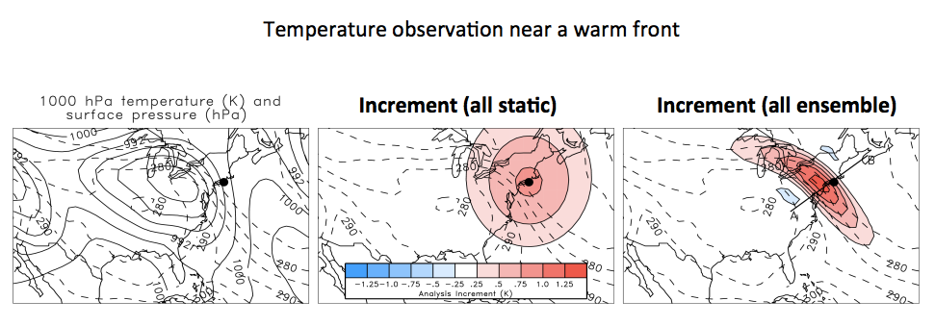
What Does B_{Ens} Do?
1. Data Assimilation Concepts 2. GSI Concepts and Methods 3. Community Support
Allows for flow-dependence/errors of the day

Slide 17
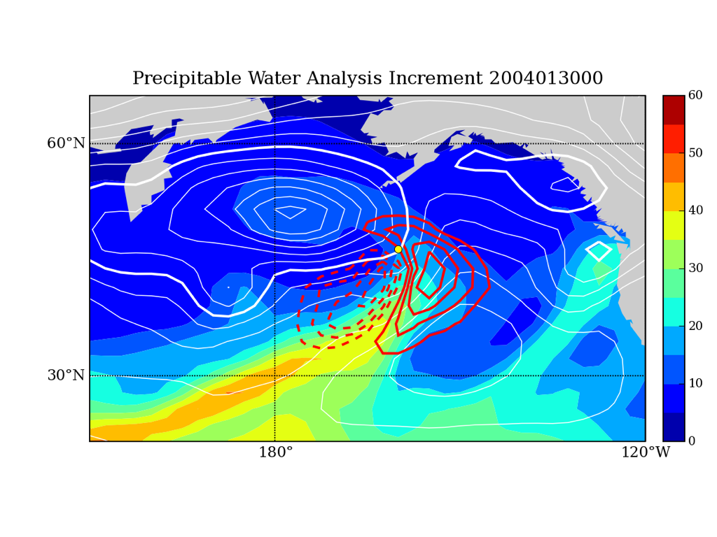
What Does B_{Ens} Do?
1. Data Assimilation Concepts 2. GSI Concepts and Methods 3. Community Support
Surface pressure observation near “atmospheric river”
P_{s} obs
First guess SLP contours
Precipitable water increment
3D-Var increment would be zero
(Cross-variable covariances hard to model with static B_{var})
Notes:
First guess surface pressure (white contours) and precipitable water increment (A-G, red contours) after assimilating a single surface pressure observation (yellow dot) using B_{e}.

Slide 18
How Does B_{Ens} Benefit Us?
1. Data Assimilation Concepts 2. GSI Concepts and Methods 3. Community Support
Allows for flow-dependence/errors of the day
Multivariate correlations from dynamic model
Quite difficult to incorporate into fixed error covariance models
Evolves with system, can capture changes in the observing network
More information extracted from the observations => better analysis => better forecasts
But B_{Ens} is not perfect…at least not yet!

Slide 19
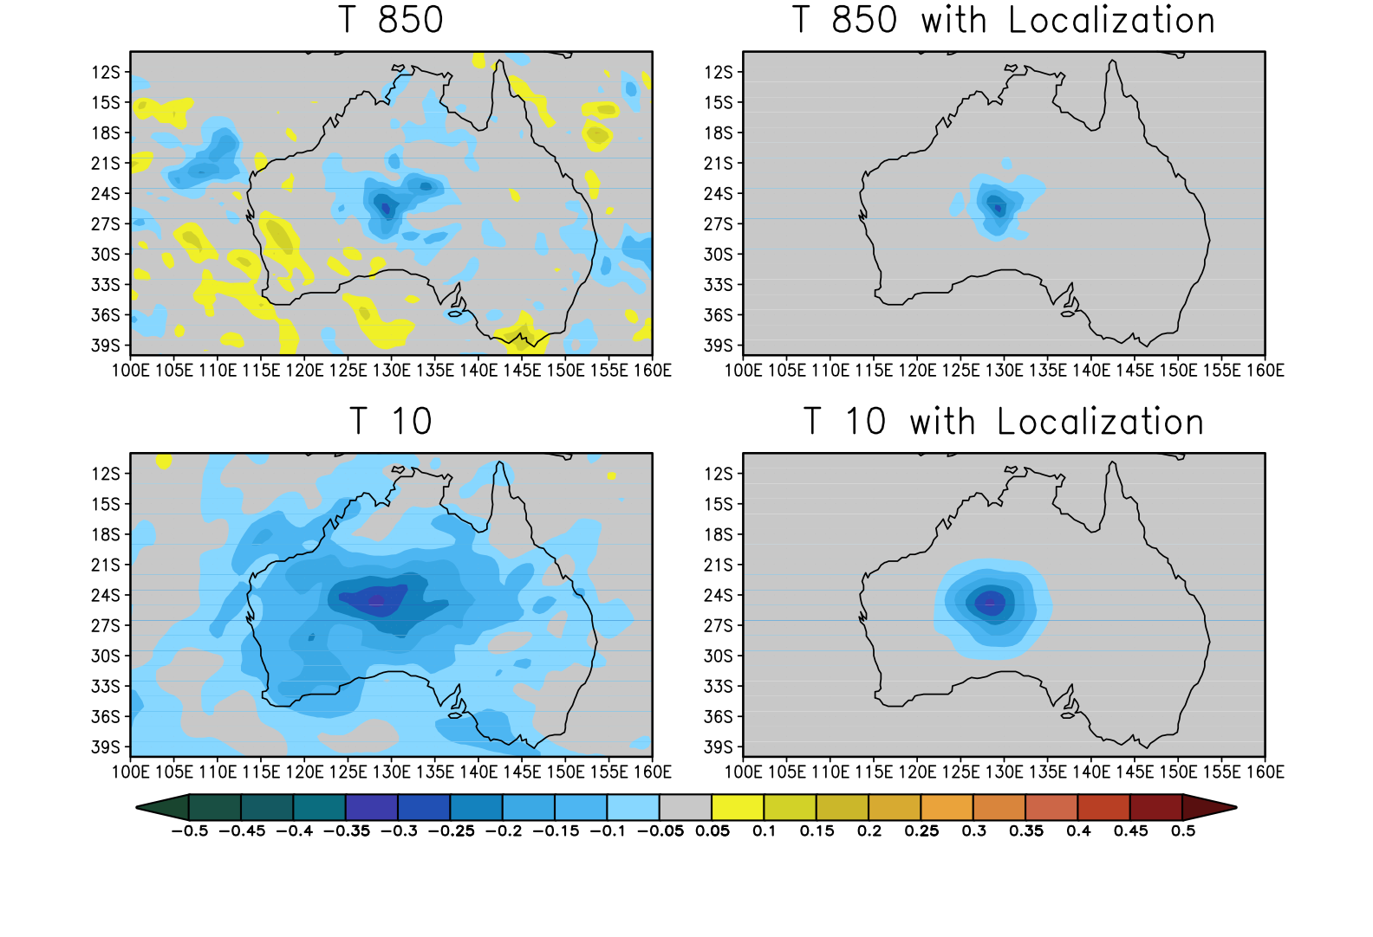
Localization of B_{Ens}
1. Data Assimilation Concepts 2. GSI Concepts and Methods 3. Community Support

Slide 20
Why Hybrid?
1. Data Assimilation Concepts 2. GSI Concepts and Methods 3. Community Support
 | VAR (3D, 4D) | EnKF | Hybrid | References
Benefit from use of flow dependent ensemble covariance instead of static B |  | x | x | Hamill and Snyder 2000; Wang et al. 2007b,2008ab, 2009b, Wang 2011; Buehner et al. 2010ab
Robust for small ensemble |  |  | x | Wang et al. 2007b, 2009b; Buehner et al. 2010b
Better localization (physical space) for integrated measure, e.g. satellite radiance |  |  | x | Campbell et al. 2009
Easy framework to add various constraints | x |  | x | Kleist 2012
Framework to treat non-Gaussianity | x |  | x
Use of various existing capabilities in VAR | x |  | x | Kleist 2012

Slide 21
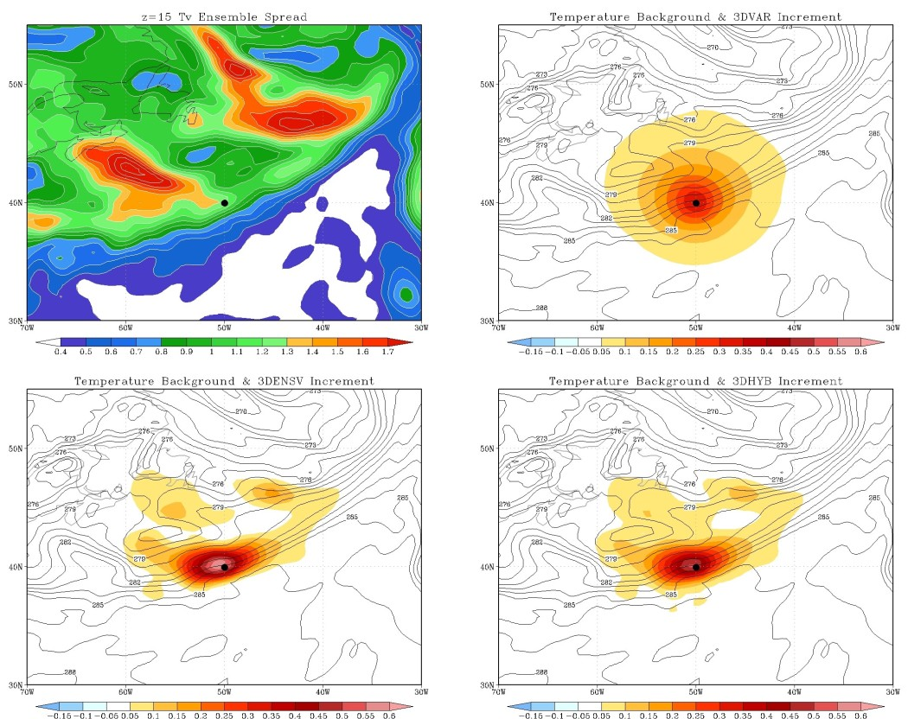
Single Temperature Observation
1. Data Assimilation Concepts 2. GSI Concepts and Methods 3. Community Support
3D-Var
Ensemble
Hybrid

Slide 22
So What’s the Catch?
1. Data Assimilation Concepts 2. GSI Concepts and Methods 3. Community Support
Need an ensemble that represents first guess uncertainty (background error)
In principle, any ensemble can be used. However, ensemble should represent well the forecast errors
This can mean O(50-100+) for NWP applications
Smaller ensembles have larger sampling error (rely more heavily on B_{Var})
Larger ensembles have increased computational expense
Updating the ensemble (NCEP) (up to 2015)
Global: an Ensemble Kalman Filter is currently used for NCEP Global Forecasting System (GFS)
Regional: using the GFS ensemble generated by the GFS & GSI-hybrid system at each analysis time (ensemble members are updated during the GFS cycle)
.

Slide 23
Coupled GSI-Hybrid Cycling (GFS)
1. Data Assimilation Concepts 2. GSI Concepts and Methods 3. Community Support
member 1
forecast
Generate new ensemble perturbations given the latest set of observations and first-guess ensemble
member 1
analysis
member 2
forecast
Ensemble Kalman
Filter (EnKF)
member update
member 2
analysis
recenter analysis ensemble
member 3
analysis
member 3
forecast
Ensemble contribution to background error covariance
Replace the EnKF ensemble mean analysis
GSI
Hybrid Ens/Var
high res
forecast
high resolution
analysis
Previous Cycle
Current Update Cycle

Slide 24
Current Scheme for Regional GSI-hybrid
1. Data Assimilation Concepts 2. GSI Concepts and Methods 3. Community Support
member 1
forecast
member 1
analysis
member 2
forecast
EnKF &
GSI-hybrid
member 2
analysis
recenter analysis ensemble
member 3
analysis
member 3
forecast
Ensemble contribution to background error covariance
GFS GSI-hybrid system
GSI
Hybrid Ens/Var
Regional
forecast
Regional
analysis
Previous Cycle
Current Update Cycle

Slide 25
Adding Time Dimension
1. Data Assimilation Concepts 2. GSI Concepts and Methods 3. Community Support
M: forecast model
k: observation time
4D-Var: using forecast model and its adjoint model for the Kalman Gain (observation based correction to background)
4D EnVar: using model ensemble forecast to replace the temporal propagation of perturbations by the tangent linear model and its adjoint. Backgorund
Hybrid 4D EnVar: Same as 4D EnVar, except the background error covariance is a combination of both static and ensemble
Hybrid 4D EnVar is being tested for GFS implementation

Slide 26
Community GSI
1. Data Assimilation Concepts 2. GSI Concepts and Methods 3. Community Support
Objective:
Provide current operational GSI capabilities to the research community (O2R) and a pathway for the research community to contribute to operational GSI (R2O)
Provide a framework to enhance the collaboration from distributed GSI developers
GSI Code support:
Community GSI repository
User’s webpage
Annual code release with user’s guide
Annual residential tutorial
Help desk
GSI code management
Unified code review-commit procedure
Development coordinated through GSI Review Committee
Public code distribution and support are through the Developmental Testbed Center (DTC)

Slide 27
Community GSI Public Release
1. Data Assimilation Concepts 2. GSI Concepts and Methods 3. Community Support
Stand alone release
Latest version is V3.4 (July, 2015)
Next release is planned for Summer 2016
Currently GSI is released together with another ensemble based DA system (GSI and EnKF)
HWRF release
Include GSI and other compoments
DTC supports
GSI community users: gsi_help@ucar.edu
HWRF: wrfhelp@ucar.edu

Slide 28
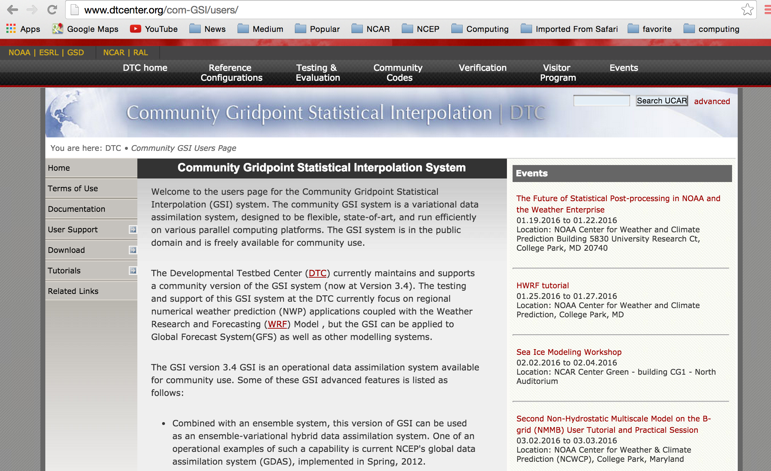
Community GSI Resources
1. Data Assimilation Concepts 2. GSI Concepts and Methods 3. Community Support
Code download (stand alone)
User’s Guide
Match each
official release
Workshop presentations
Tutorial lectures
Online tutorial and practical cases
Code browser
http://www.dtcenter.org/com-GSI/users/index.php

Slide 29
Reference
Data Assimilation Concept and Methods (ECMWF Training Course, Bouttier & Courtier)
GSI Tutorial Lectures:
GSI overview (John Derber, Ming Hu)
Fundamentals of Data Assimilation (Tom Auligne)
Background and Observation Errors (Daryl Kleist)
GSI Hybrid Data Assimilation (Jeff Whitaker, Daryl Kleist)
Aerosol Data Assimilation (Zhiquan Liu)

